Slide 1
Introduction to Amos
In this tutorial, you will be briefly introduced to the student version of the structural equation modeling (or SEM) software known as Amos. To obtain a free copy, go to www.amosdevelopment.com.
You should also download the current Amos manual while you are at the site, as it has many valuable illustrations of SEM procedures.
Notes:
In this tutorial, you will be briefly introduced to the student version of the structural equation modeling (or SEM) software known as Amos. To obtain the free version of Amos, you should go to www.amosdevelopment.com. You should also download the current Amos manual while you are at the site, as it has many valuable illustrations of SEM procedures.

Slide 2
Why Start with Amos?
For those starting out, I feel that it is worth starting with the free version of Amos even if you plan to use some other software for your serious work. Why? (1) because the software learning curve for Amos is very short, (2) none of the other packages have manuals that are well suited for the beginning student to learn about SEM, and (3) Amos gives very explicit specification of models, which is helpful when starting out.
Notes:
For those starting out, I feel that it is worth starting with the free version of Amos even if you plan to use some other software for your serious work. Why?, (1) because the software learning curve for Amos is very short, (2) none of the other packages have manuals that are well suited for the beginning student to learn about SEM, and (3) Amos gives very explicit specification of models, which is helpful when starting out.
There are quite a few software programs currently available for performing structural equation modeling. Those beginning with SEM inevitably wish to know which of these programs is best. One point in this regard is that most of these programs are updated fairly frequently, making any description I might give of the limitations of a program potentially out of date very quickly. Another point to make is that different individuals prefer different features. Some want the software that will allow them to get started most quickly, others want the software with the most capabilities, still others want the software that is freely available to them. After some consideration, I have come to the conclusion that it is best for most folks start with the free version of Amos even if they plan to use some other software for their serious work. Those who have followed this advice seem to find that gaining some familiarity with the Amos manual alone is well worth the time spent in this platform.

Slide 3
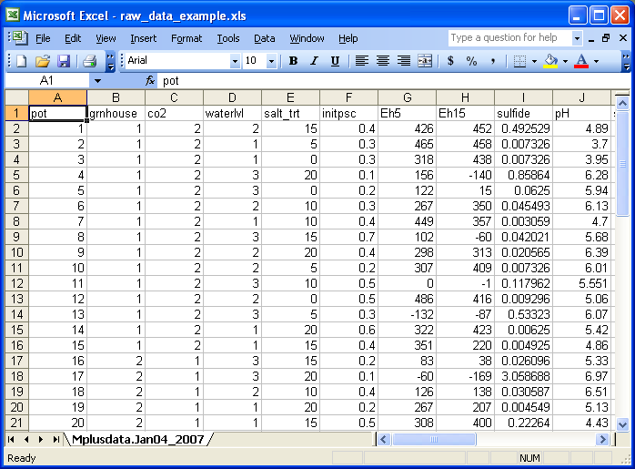
Example of Excel Data File – Raw Data Format
The standard way to format data is with variables in columns and cases
in rows. Note that for missing data, the cells should be left blank.
Notes:
A good place to start is with data files. Most commonly one will work with single excel spreadsheets where variables are in columns and cases are in rows. Amos is able to directly access such spreadsheets. Be aware that for missing data, cells in the spreadsheet should be left blank.

Slide 4
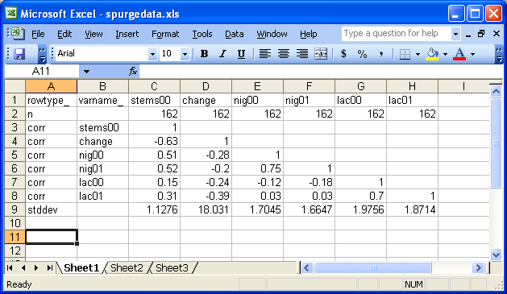
Other Data Formats Amos Can Read in Excel
Note that we have the choice of either inputting the raw data, which is
preferred when it is available, or in the form of a correlation matrix (as
shown), or in the form of a raw covariance matrix.
Notes:
For teaching purposes it is convenient to use summary data instead of raw data. The convenience comes from both the utility of looking directly at the correlation structure of the data and from the fact that it is easier to get permission to distribute data summarizes than it is raw data. In Amos, the procedures are the same for accessing data. The above illustrates the format required for summary data. Note that in addition to sample size, correlations and standard deviations, one may also include the means. When the means are omitted, as in the above example, certain procedures are not possible. Also, some procedures are not possible in Amos with summary data of any sort, for example, bootstrapping or Bayesian estimation.

Slide 5
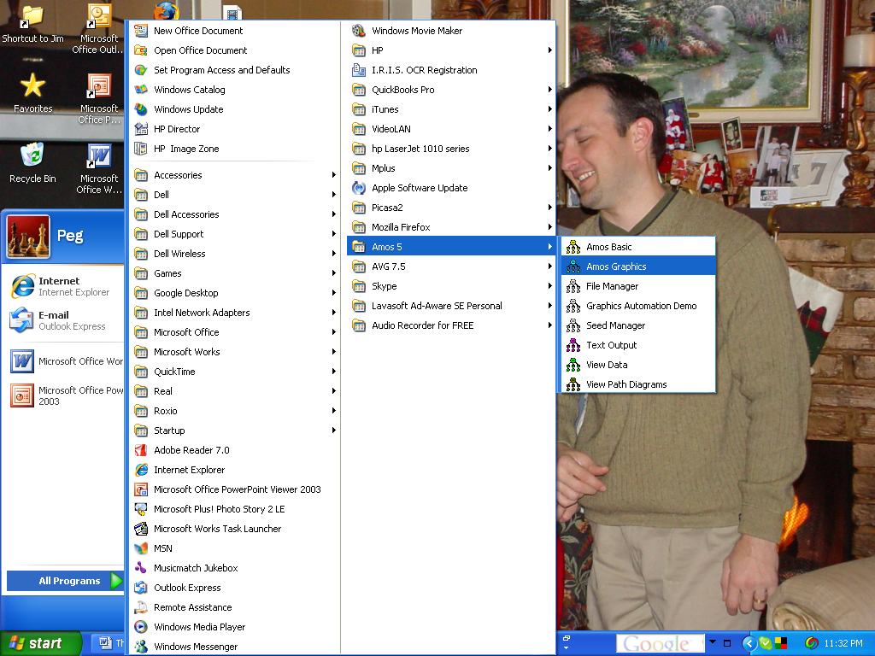
Launching Amos
From among the many modules that
come with Amos, you want to start by
opening "Amos Graphics".
Notes:
How do you launch Amos? Amos installation gives you a set of modules without any indication of which one you want to use to get started. Select Amos Graphics. This will take you to where you want to be.

Slide 6
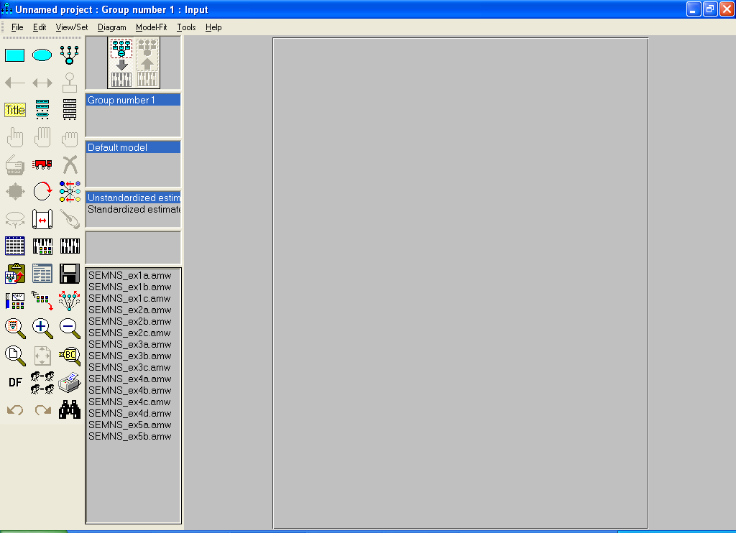
The Amos Graphics Graphical User Interface (GUI)
There are often several different
ways one can execute options in
Amos. In this tutorial, I will tend to
use icons rather than dropdown
menus. Also, numerous options
can be executed from a right click
of the mouse.
Notes:
There are generally three different ways to operate in the Amos environment. One is to use icons, which are grouped to the left in this view. A second way to access features is through the drop down menus. Finally, some features can be access by right clicking. I will not provide an exhaustive introduction, but rather, will leave it to the individual to explore this intuitive framework.

Slide 7
Step 1: Open your data file.
This icon, which looks like an
Excel spreadsheet, is used to
open data files and link them
to your model.
Notes:
The first thing we will do is to open a data file. If there is a diagram on the palette when you open Amos, you will need to select New from the File dropdown menu to get started. While we could to the File drop down and select Data files to access data, instead, I will direct you to the icon on the left that looks like a miniature spreadsheet.

Slide 8
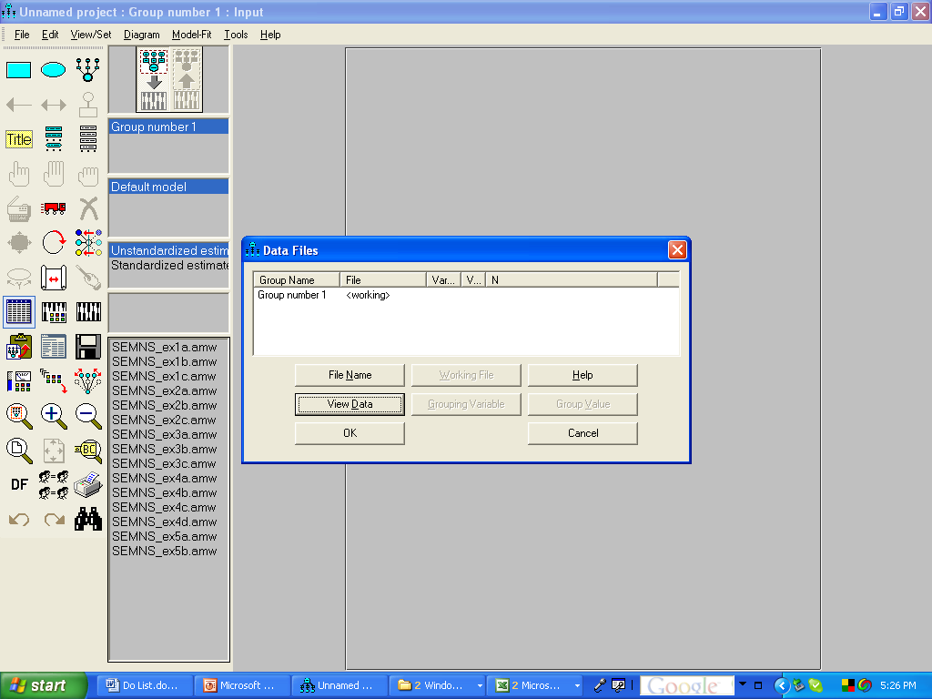
Step 1: Open your data file. (continued)
Once you click on the data file icon, you encounter the data file manager.
Now, click on File Name.
Notes:
Once you access the data file manager, you can browse for files by selecting the button entitled “File name”.

Slide 9
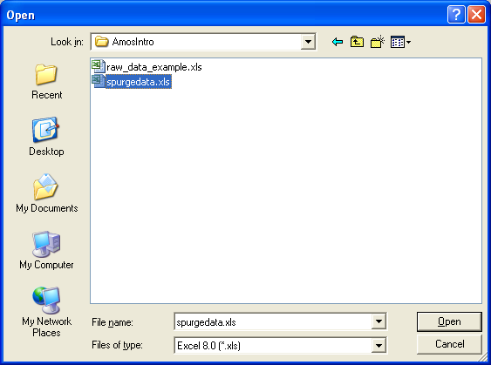
Step 1: Open your data file. (continued)
Notes:
Now you will browse in the normal fashion. Here we have the choice of selecting either a raw data example file or the spurgedata file.

Slide 10
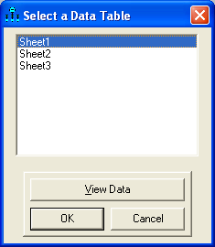
Step 1: Open your data file. (continued)
You will need to choose the sheet in Excel file you want to use before
clicking OK.
Notes:
If the selected excel file has multiple sheets, you must chose the one you wish to read.

Slide 11
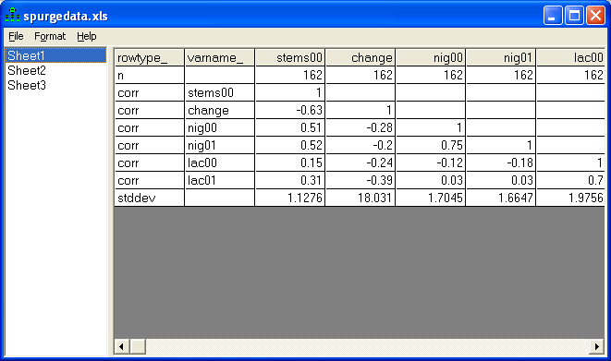
Step 1: Open your data file. (continued)
You can view the data in the datasheet either before or after selecting
this as the dataset you want to use. Once you say, OK, you have opened
the dataset and can access the variables.
Notes:
Once you choose to open a file, you will be given the option of either viewing the contents of that file or selecting OK to accept that file. You can view the file contents either before or after you select OK.

Slide 12
Step 2: Dragging observed variables to the palette.
This icon gives you the list of
variables in the dataset.
Notes:
Now that we have told Amos where to find the data, we can take advantage of one of its handy features to get access to the variables in the dataset. Here we select the icon shown at the end of the red arrow. Alternatively, we could go to the dropdown label View/Set and then select Variables in dataset.

Slide 13
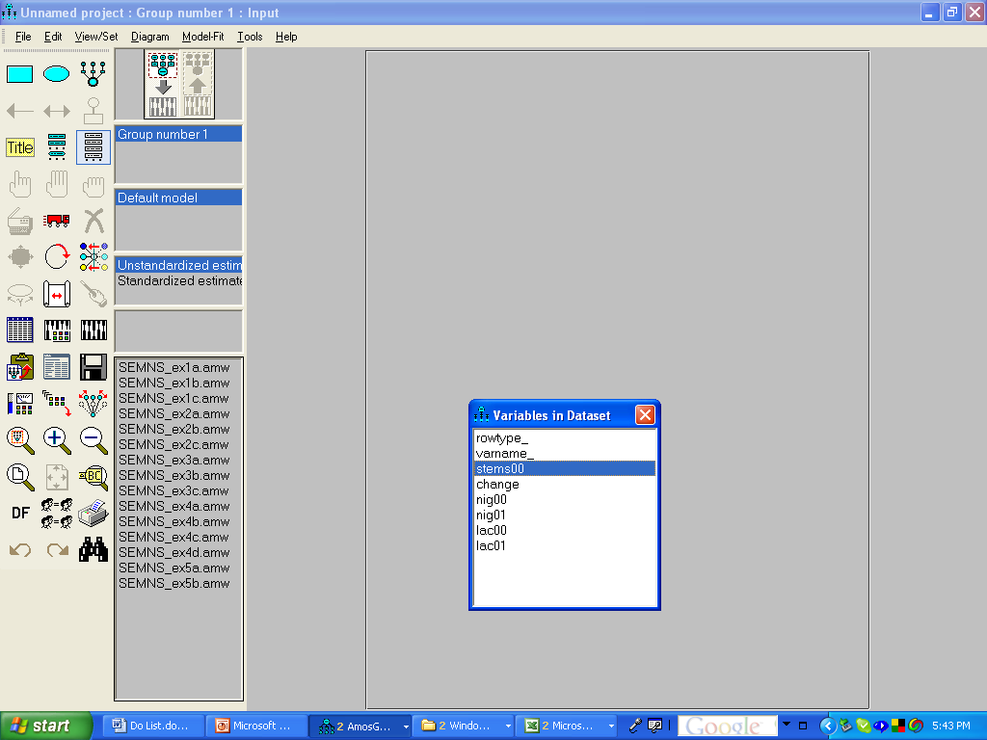
Step 2: Dragging observed variables to the palette.
(continued)
By selecting and holding down
the mouse key, you can drag
variables to the palette.
Notes:
Now, we are in a position to click and drag labels onto the palette.

Slide 14
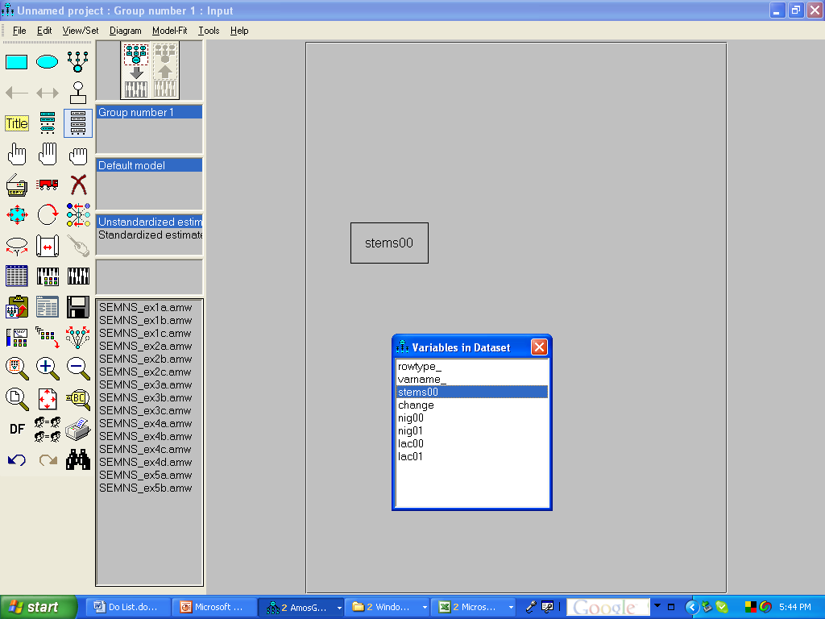
Step 2: Dragging observed variables to the palette.
(continued)
Observed variables are shown
as rectangles.
Notes:
Variables from the dataset that are dragged to the palette will be in boxes since these are observed variables and the rectangle represents observed variables. As an alternative to the dragging variables onto the palette, we could draw rectangles and then edit them by adding a variable name, which automatically tells Amos what data to use.

Slide 15
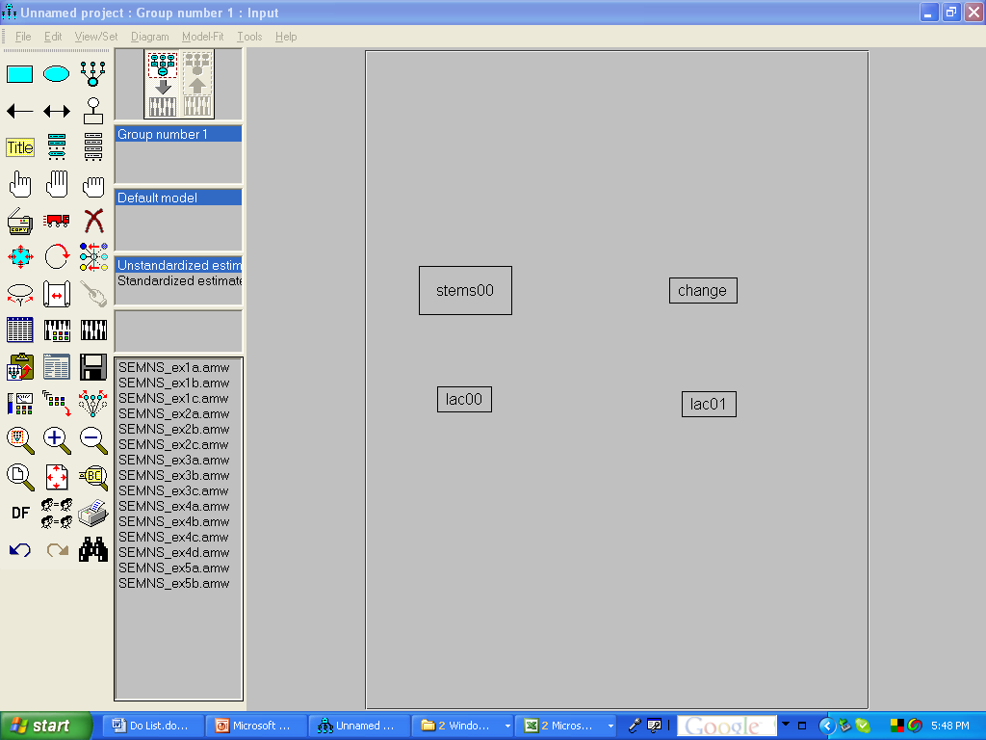
Step 3: Once variables are in on palette, you can
move them and resize/reshape them (for aesthetics).
Tool to use for moving things.
Tool to use for reshaping things.
Notes:
When variables are dragged to the palette they are usually different sizes and in odd positions. We can clean all that up a couple of ways, the simplest is to use the shape and moving tools as indicated by the red arrows. The use of these tools, once selected, should be easy to figure out.

Slide 16
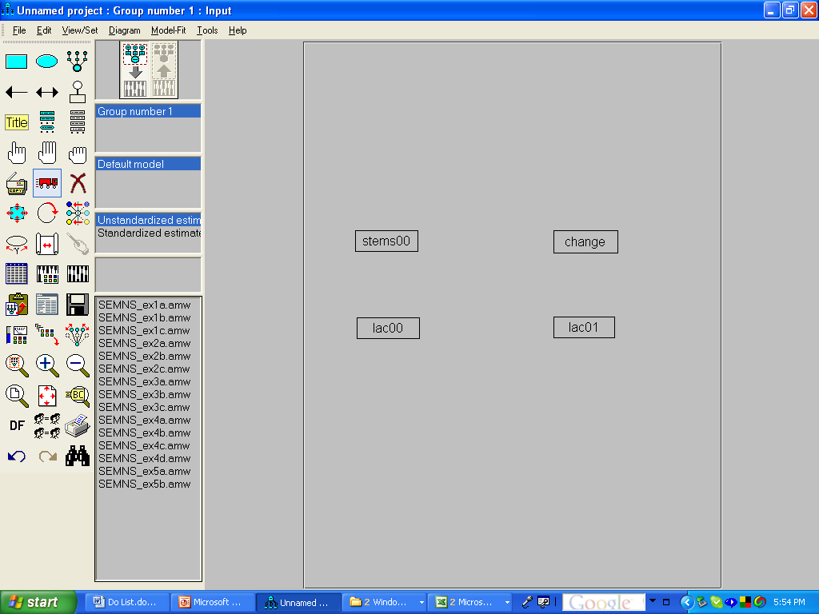
Step 3: Once variables are on palette, you can
move them and resize/reshape them. (continued)
Notes:
Now, this slide shows the results of our work reshaping and moving variables.

Slide 17
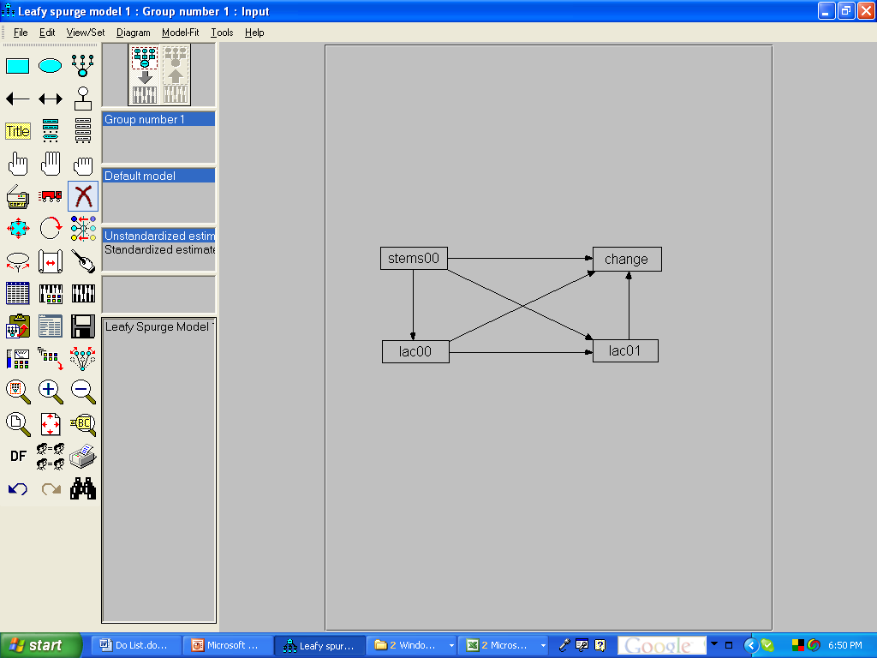
Step 4: Drawing arrows.
Tool to use for drawing directional
arrows between variables.
If you want to erase anything
(e.g., arrow or variable), use
this tool.
Notes:
Next, we are ready to add arrows, which will be used to develop equations (behind the scenes). If you need to erase anything, such as an arrow, you can use the freehand X icon.

Slide 18
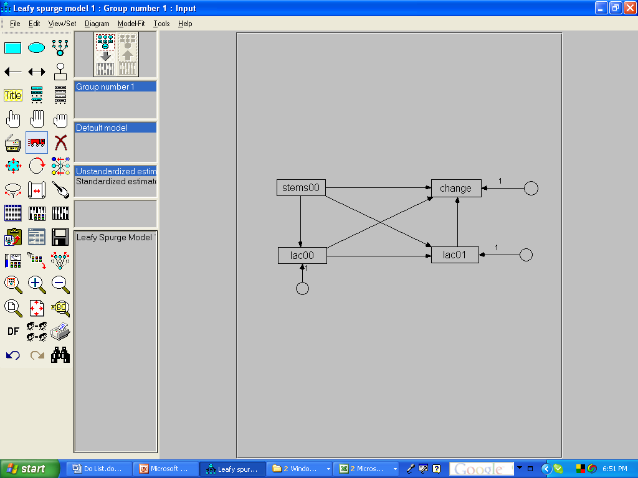
Step 5: Adding error variables.
Response (endogenous) variables
require error terms. These error
terms are represented as error
variables. We can add them by
selecting this tool and clicking on
the response variables.
Try clicking the error term tool over
an endogenous variable repeatedly
to see what that does.
Notes:
Since Amos requires you to explicitly specify your model, you will always have to add error terms for each endogenous observed variable in a path model. Amos also uses the convention of representing error terms as latent variables. Amos has a tool that makes the addition of error variables easy and the icon for this tool is shown at the end of the red arrow. You can determine the compass heading of the error variable by clicking repeatedly while holding the error variable took over the recipient, named variable. Don’t worry if the size of the circle is too large or too small or if the length of the arrow coming from the error variable is too long or too short for your preferences, you will be able to adjust all that after the fact.

Slide 19
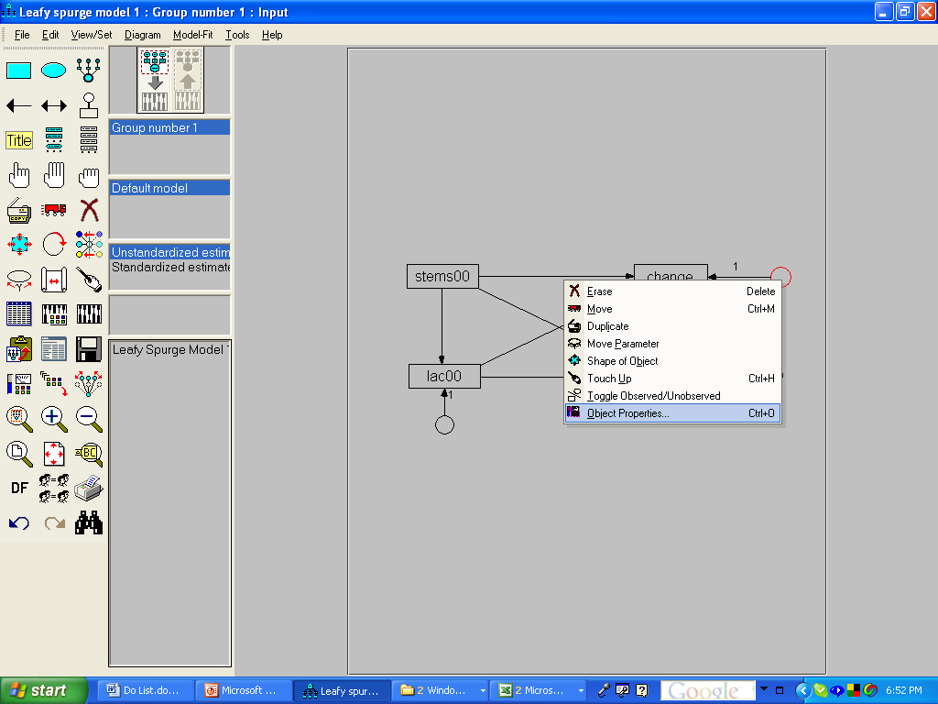
Step 6: Naming error variables.
All variables must have names,
this applies to the error variables
too. To name the error variables,
you must highlight them,
right click, and select Object
Properties.
Notes:
Once you add an error variable to a diagram, you will need to give it a name. To do this, right click on the error variable and choose the option called “Object Properties”.

Slide 20
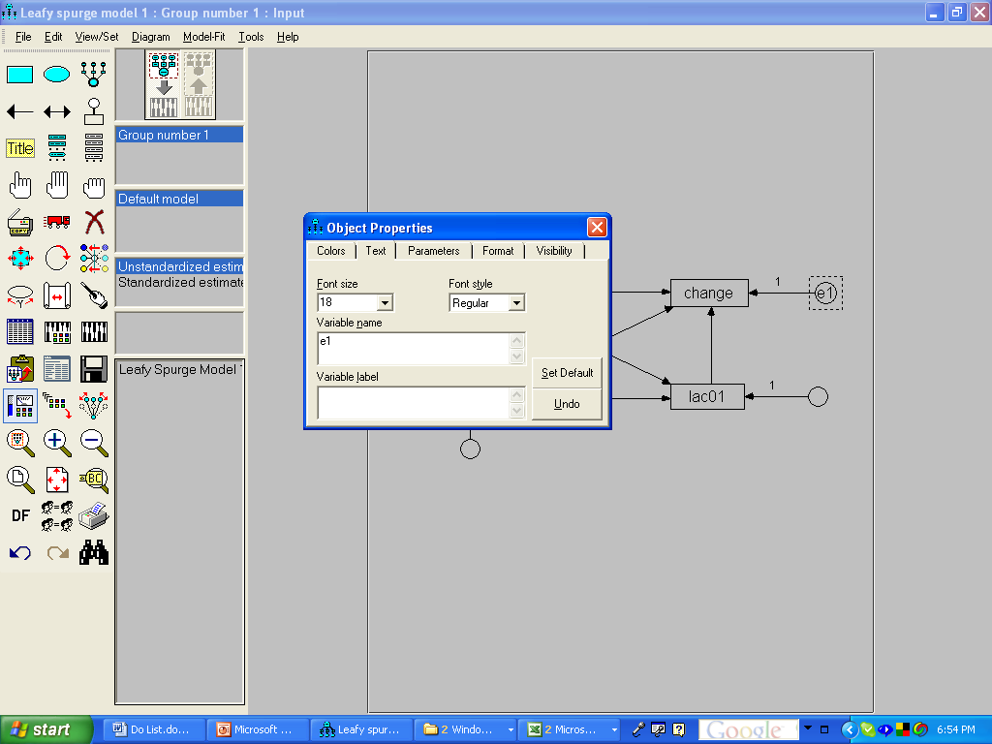
Step 6: Naming error variables. (continued)
Note that error variables have
unstandardized regression weights
of 1.0, which are shown.
Simply by typing a name into
the form, we name the variable.
We can leave the window open
and click on any object to modify
its properties. To accept changes,
simple close the window by clicking
the square with the red X.
Notes:
The object properties box allows you to do many different things if needed. For now we are going to simply give the highlighted error variable a name. Here I simply use e1 as the name. We do not need to close the object properties box to proceed to the next error variable. Instead, if we simple click on any other object, the dialog switches to relate to whatever object is highlighted. It is worth checking out the features that can be accessed and specified in the object properties box. When you are done, click on the square with the red x.

Slide 21
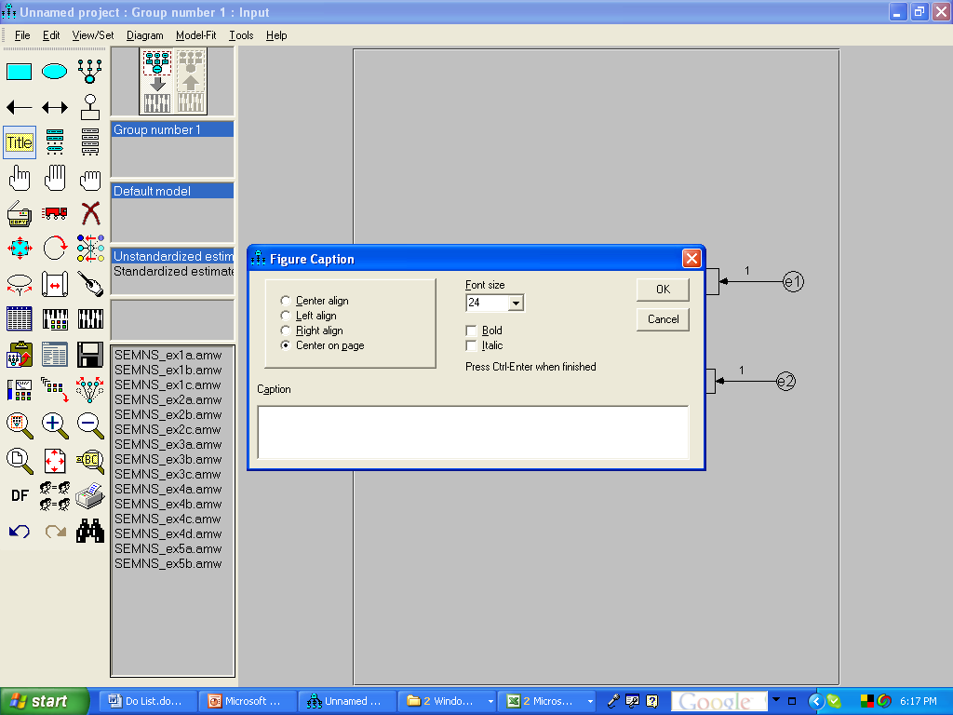
Step 7: Adding a title to our model.
Select the Title tool and then
click at the place on the palette
where you want the title to go.
The title tool gives you a chance
to both enter the caption text and
to set its properties.
Notes:
Next we are going to add a title to our palette. Click the title icon and then the location on the palette where you want the label to go. The dialog box allows you to specify a descriptive identifier for this particular model.

Slide 22
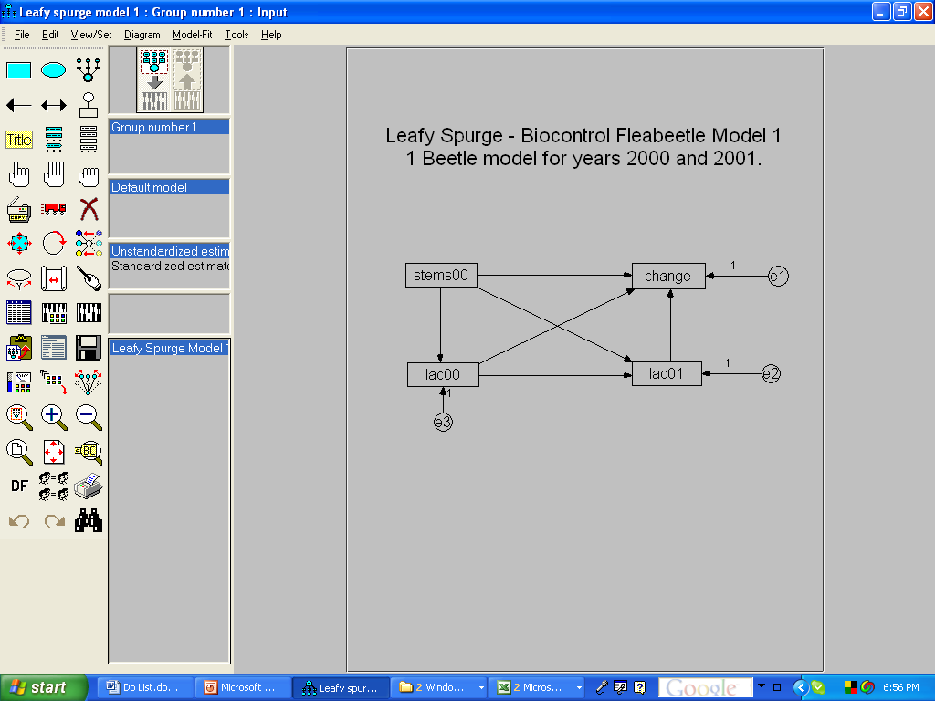
Step 8: Now we had better save our model.
The icon that looks like a floppy
disk executes the save command.
Notes:
To save your work you can either go to the file pull down menu and select save or simply select the icon that looks like a floppy disk.

Slide 23
Step 9: Setting the run parameters.
To set the run parameters, we
click this icon.
Notes:
Since we have completed constructing our model and have named all variables, we have graphically specified the equations that represent our model. Implied by the architecture of the model are a rather large number of scientific questions that we can address based on the results derived from the analysis of these equations. For example, evaluation of the path from stems00, which represents leafy spurge stem density, to lac00, which represents the density of fleabeetles found in the plots, provides us an estimate of the degree to which the fleabeetle tracks its food resource. Evaluating the path from lac00 to lac01 permits us to estimate the degree of fidelity shown by the fleabeetle over time. The path directly from stems00 to lac01 represents the lag effect of food on beetles the next year above and beyond the indirect effect exerted by food carried over time. There are several other important biological questions that will be addressed about the processes implied by the network of pathways and we generally think that each pathway, direct or indirect, represents a different process of interest. Before all these processes can be evaluated, we need to specify various parameters associated with the analysis and output processes. To access these, we can either go to the dropdown menu View/Set and then select analysis properties or we can go to the icon shown at the tip of the red arrow.

Slide 24
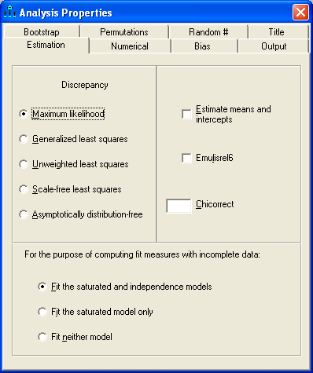
Step 9: Setting the run parameters. (continued)
There are a great many options encountered here. Right now we will keep things as simply as possible and only concern ourselves with options relating to output, which are located on the output tab.
Notes:
Once we click the analysis properties icon, we access a dialog box with a large number of options. For example, on the Estimation tab, shown here, we can not only choose from among several estimation methods, we can also choose whether we want to estimate means and intercepts in addition to covariances. In this particular example, because we are using summary data and we did not include the means as part of the data summary, we cannot select that option. For now, lets just select the Output tab.

Slide 25
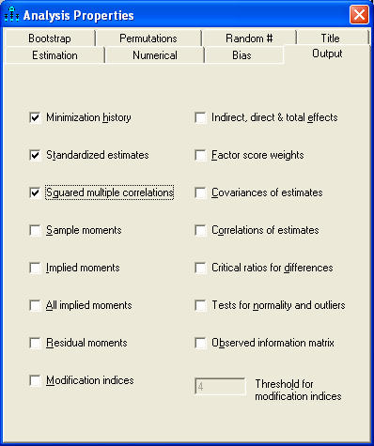
Step 9: Setting the run parameters. (continued)
On the Output tab, there are many options of interest. Right now we will only select “Standardized estimates” and “Squared multiple correlations”.
Clicking on the red X closes the window, leaving us ready to run the model.
Notes:
On the output tab, there are many options of interest. Right now we will only select Standardized Estimates and Squared multiple correlations as additional output.

Slide 26
Step 10: Running the model (estimating parameters).
The abacus icon initiates the
calculation process.
Notes:
To run the model, which means initiating the estimation and reporting processes, you can choose the Model-Fit dropdown menu or simply press the icon that looks like an abacus.

Slide 27
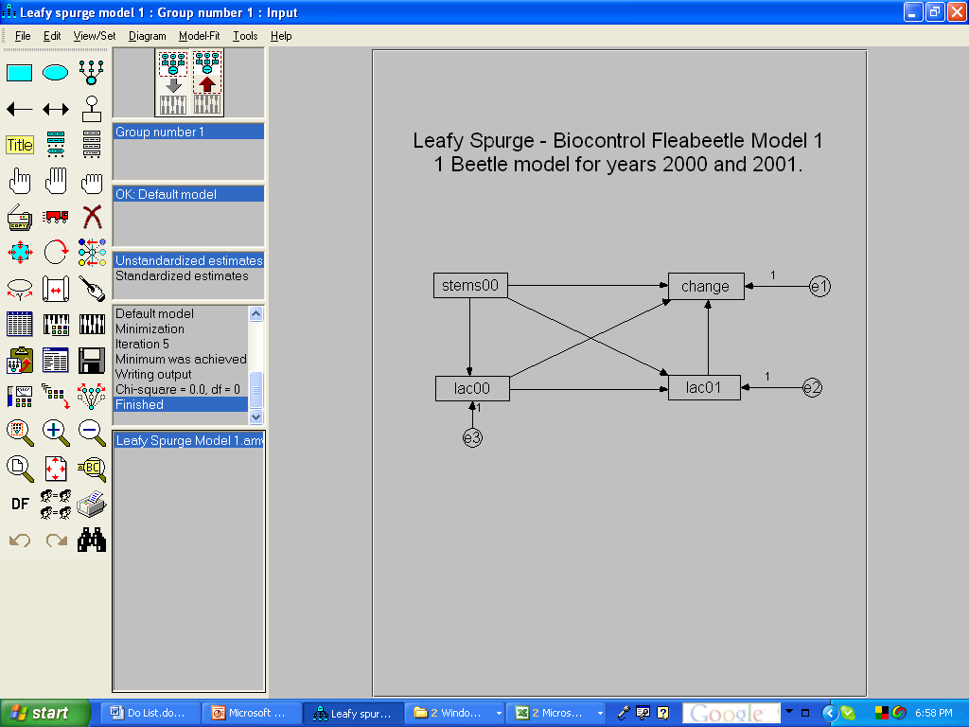
Step 11: Getting to the results.
It is helpful to resize this
window so you can get a
peek at the chi-square and
df of the model after it runs.
To access the full results, this is
the icon you will need to click.
Notes:
You will see text scrolling in a small window to the right of the icons and you may find it helpful to resize that window so you can see more of the results from this view. While it is possible to have some of the results displayed directly on the palette, to access the full results, we need to click the results icon shown, or select View/Set from the dropdown menus and then choose Text Output.

Slide 28
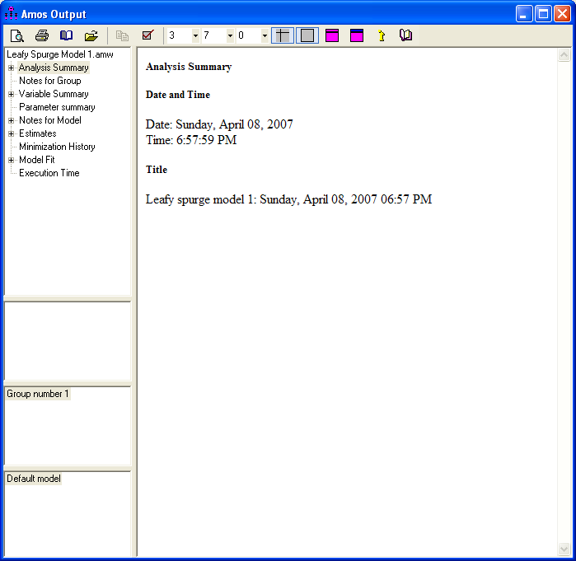
Step 11: Looking at results.
Amos uses a directory tree to organize
model output. You should look through
all the output to get familiar with where
information is located.
Notes:
Amos is organized in such a fashion that you can learn a great deal about the estimation process, the properties of the data, and the results by exploring the various types of output. Of particular important will be to view the Notes for Model which will tell you whether the run was successful.

Slide 29
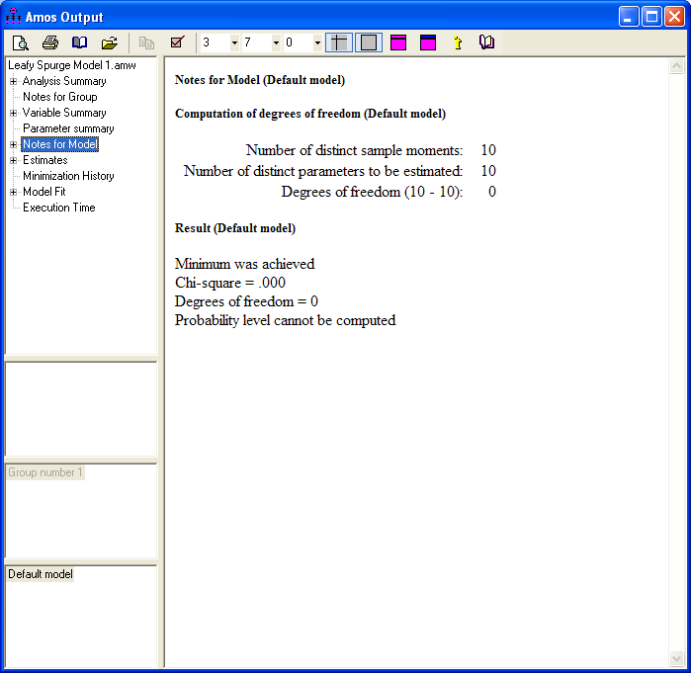
Step 11: Looking at results.
Here we can see that a minimum was achieved, which is one indication that our analysis was successful in terms of obtaining results we can trust. In this case, our model is saturated and we have no degrees of freedom. In such a situation we do not need to worry about model fit problems and we can go directly to look at the parameter estimates.
Notes:
When we look at the Notes for Model, we see several useful pieces of information. Of particular importance is that a minimum was achieved, which refers to a stable solution that minimizes the discrepancies between observed and model-implied covariances. In this case, our model is saturated, our model chi-square is zero, and there should be no discrepancies between data and model.

Slide 30
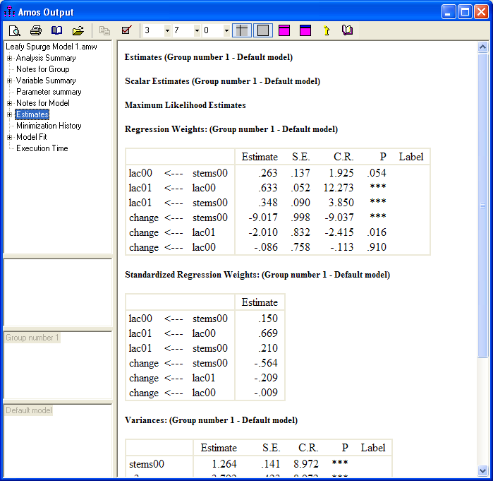
Step 11: Looking at results. (continued)
Once we determine that our
model fit is acceptable, our focus is placed on the estimates, their standard errors, the critical ratios (which are like t-tests), and the associated p-values.
Since we requested standardized values, they are presented in the output.
Notes:
Once we determine that our model fit is acceptable, our focus is placed on the estimates, their standard errors, the critical ratios, which are like t-tests, and the associated p-values. Looking at the regression weights, we can see that two of the p-values are at or above the conventional cutoff value of 0.05, which suggests that we might want to consider some modifications to our model. It is not our purpose here to delve into this issue, but instead to simply point out what output is available. Note that the since we requested standardized values, the standardized regression weights are also given. You can scroll down to see more results.

Slide 31
Wrap Up
This tutorial focused on the mechanics of specifying a model in Amos. Issues related to model building, model testing, and interpretation are covered elsewhere.
Notes:
In this tutorial, I sought to simply give a brief introduction to the software Amos. Additional information about model building, model testing, and interpretation can be found in textbooks on SEM or in other tutorials.

